Slide 1



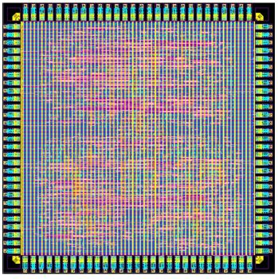
Accelerator for Genetic Local Sequence Alignment
Frontend Design Review
Students: Niv Bar-Tov, Dor Lerman
Supervisor: Goel Samuel

Slide 2
Outline
Sequence Alignment
Smith-Waterman Algorithm
Project’s Requirements and Specifications
High-Level Overview
Architectural Design
Next Steps
1

Slide 3
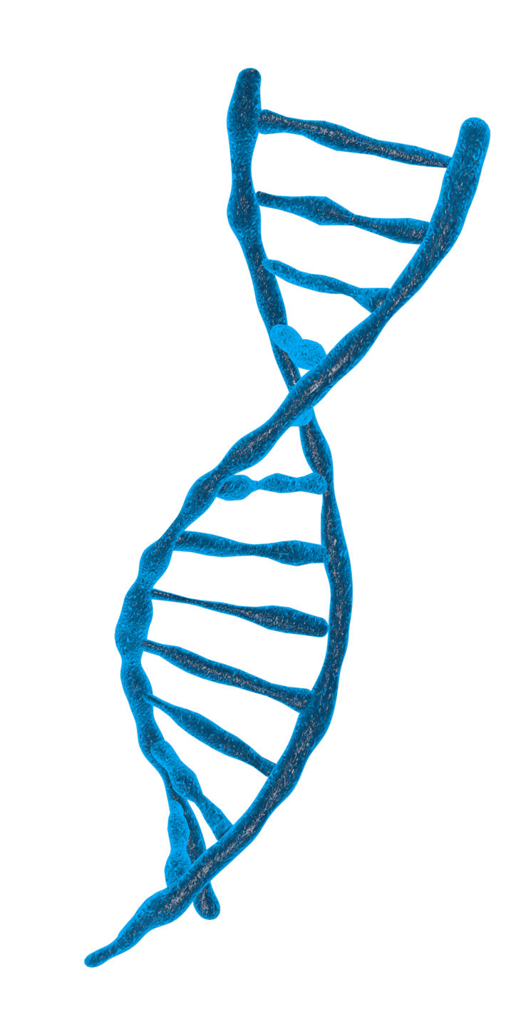
Sequence Alignment
Method of arranging sequences of DNA, RNA or proteins
Aims to identify regions of similarity that may indicate on a relationship between the sequences
Can be used also for non-biological sequences
2

Slide 4
Sequence Alignment
TACGCTTG
CTACCTAG
TAC
–
CT
TACGCT
3

Slide 5
Global Alignment VS. Local Alignment
Align the entire sequence (all letters)
Suitable for closely related sequences
Needleman-Wunsch Algorithm
Align regions (substrings) having highest similarities
Suitable for more divergent sequences
Smith-Waterman Algorithm
4

Slide 6
Smith-Waterman Algorithm
Dynamic Programming algorithm used for local sequence alignment
Compares segments of all possible lengths and optimizes the similarity measure
Time complexity: O(n²)
Space complexity: O(n²)
5

Slide 7
Smith-Waterman Main Stages
Initialization: Construct a scoring matrix and initialize its first row and column with zeros
Scoring: Calculate score for each cell based on the scoring scheme
Traceback: Determine the optimal alignment by trace back from the highest-scoring cell in the matrix to a cell with a score of zero
6

Slide 8
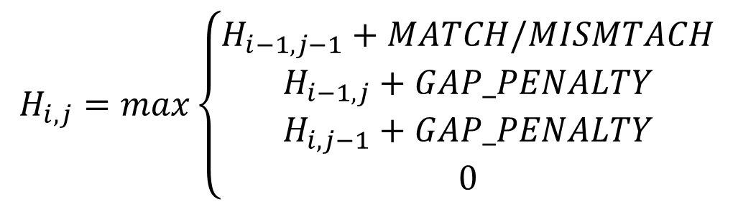
Smith-Waterman Algorithm Initialization
$$H_{i,j}=max\left\{\begin{aligned}H_{i−1,j−1}+MATCH/MISMTACH \\ H_{i−1,j}+GAP_PENALTY \\ H_{i,j−1}+GAP_PENALTY \\ 0\end{aligned}\right.$$
G | T | T | C | G | C | A | T |  | S
0 | 0 | 0 | 0 | 0 | 0 | 0 | 0 | 0
 |  |  |  |  |  |  |  | 0 | C
 |  |  |  |  |  |  |  | 0 | T
 |  |  |  |  |  |  |  | 0 | A
 |  |  |  |  |  |  |  | 0 | C
 |  |  |  |  |  |  |  | 0 | C
 |  |  |  |  |  |  |  | 0 | T
 |  |  |  |  |  |  |  | 0 | A
 |  |  |  |  |  |  |  | 0 | G
+1 | Match
–1 | Mismatch
–2 | Gap Penalty
7

Slide 9
Smith-Waterman Algorithm Scoring
$$H_{i,j}=max\left\{\begin{aligned}H_{i−1,j−1}+MATCH/MISMTACH \\ H_{i−1,j}+GAP_PENALTY \\ H_{i,j−1}+GAP_PENALTY \\ 0\end{aligned}\right.$$
G | T | T | C | G | C | A | T |  | S
0 | 0 | 0 | 0 | 0 | 0 | 0 | 0 | 0
 |  |  |  |  |  |  | 0 | 0 | C
 |  |  |  |  |  |  |  | 0 | T
 |  |  |  |  |  |  |  | 0 | A
 |  |  |  |  |  |  |  | 0 | C
 |  |  |  |  |  |  |  | 0 | C
 |  |  |  |  |  |  |  | 0 | T
 |  |  |  |  |  |  |  | 0 | A
 |  |  |  |  |  |  |  | 0 | G
+1 | Match
–1 | Mismatch
–2 | Gap Penalty
7

Slide 10
Smith-Waterman Algorithm Scoring
$$H_{i,j}=max\left\{\begin{aligned}H_{i−1,j−1}+MATCH/MISMTACH \\ H_{i−1,j}+GAP_PENALTY \\ H_{i,j−1}+GAP_PENALTY \\ 0\end{aligned}\right.$$
G | T | T | C | G | C | A | T |  | S
0 | 0 | 0 | 0 | 0 | 0 | 0 | 0 | 0
 |  |  |  |  |  | 0 | 0 | 0 | C
 |  |  |  |  |  |  | 1 | 0 | T
 |  |  |  |  |  |  |  | 0 | A
 |  |  |  |  |  |  |  | 0 | C
 |  |  |  |  |  |  |  | 0 | C
 |  |  |  |  |  |  |  | 0 | T
 |  |  |  |  |  |  |  | 0 | A
 |  |  |  |  |  |  |  | 0 | G
+1 | Match
–1 | Mismatch
–2 | Gap Penalty
7

Slide 11
Smith-Waterman Algorithm Scoring
$$H_{i,j}=max\left\{\begin{aligned}H_{i−1,j−1}+MATCH/MISMTACH \\ H_{i−1,j}+GAP_PENALTY \\ H_{i,j−1}+GAP_PENALTY \\ 0\end{aligned}\right.$$
G | T | T | C | G | C | A | T |  | S
0 | 0 | 0 | 0 | 0 | 0 | 0 | 0 | 0
 |  |  |  |  | 1 | 0 | 0 | 0 | C
 |  |  |  |  |  | 0 | 1 | 0 | T
 |  |  |  |  |  |  | 0 | 0 | A
 |  |  |  |  |  |  |  | 0 | C
 |  |  |  |  |  |  |  | 0 | C
 |  |  |  |  |  |  |  | 0 | T
 |  |  |  |  |  |  |  | 0 | A
 |  |  |  |  |  |  |  | 0 | G
+1 | Match
–1 | Mismatch
–2 | Gap Penalty
7

Slide 12
Smith-Waterman Algorithm Scoring
$$H_{i,j}=max\left\{\begin{aligned}H_{i−1,j−1}+MATCH/MISMTACH \\ H_{i−1,j}+GAP_PENALTY \\ H_{i,j−1}+GAP_PENALTY \\ 0\end{aligned}\right.$$
G | T | T | C | G | C | A | T |  | S
0 | 0 | 0 | 0 | 0 | 0 | 0 | 0 | 0
0 | 0 | 0 | 1 | 0 | 1 | 0 | 0 | 0 | C
0 | 1 | 2 | 0 | 0 | 0 | 0 | 1 | 0 | T
0 | 1 | 0 | 0 | 0 | 0 | 2 | 0 | 0 | A
0 | 0 | 0 | 1 | 1 | 3 | 0 | 0 | 0 | C
0 | 0 | 0 | 2 | 2 | 1 | 0 | 0 | 0 | C
0 | 1 | 3 | 1 | 0 | 0 | 0 | 1 | 0 | T
0 | 2 | 1 | 0 | 0 | 0 | 2 | 0 | 0 | A
3 | 0 | 0 | 0 | 1 | 1 | 0 | 0 | 0 | G
+1 | Match
–1 | Mismatch
–2 | Gap Penalty
7

Slide 13
Smith-Waterman Algorithm Traceback
G | T | T | C | G | C | A | T |  | S
0 | 0 | 0 | 0 | 0 | 0 | 0 | 0 | 0
0 | 0 | 0 | 1 | 0 | 1 | 0 | 0 | 0 | C
0 | 1 | 2 | 0 | 0 | 0 | 0 | 1 | 0 | T
0 | 1 | 0 | 0 | 0 | 0 | 2 | 0 | 0 | A
0 | 0 | 0 | 1 | 1 | 3 | 0 | 0 | 0 | C
0 | 0 | 0 | 2 | 2 | 1 | 0 | 0 | 0 | C
0 | 1 | 3 | 1 | 0 | 0 | 0 | 1 | 0 | T
0 | 2 | 1 | 0 | 0 | 0 | 2 | 0 | 0 | A
3 | 0 | 0 | 0 | 1 | 1 | 0 | 0 | 0 | G
+1 | Match
–1 | Mismatch
–2 | Gap Penalty
7

Slide 14
Smith-Waterman Algorithm Traceback
G | T | T | C | G | C | A | T |  | S
0 | 0 | 0 | 0 | 0 | 0 | 0 | 0 | 0
0 | 0 | 0 | 1 | 0 | 1 | 0 | 0 | 0 | C
0 | 1 | 2 | 0 | 0 | 0 | 0 | 1 | 0 | T
0 | 1 | 0 | 0 | 0 | 0 | 2 | 0 | 0 | A
0 | 0 | 0 | 1 | 1 | 3 | 0 | 0 | 0 | C
0 | 0 | 0 | 2 | 2 | 1 | 0 | 0 | 0 | C
0 | 1 | 3 | 1 | 0 | 0 | 0 | 1 | 0 | T
0 | 2 | 1 | 0 | 0 | 0 | 2 | 0 | 0 | A
3 | 0 | 0 | 0 | 1 | 1 | 0 | 0 | 0 | G
TAC
TAC
+1 | Match
–1 | Mismatch
–2 | Gap Penalty
7

Slide 15
Smith-Waterman Algorithm Traceback
G | T | T | C | G | C | A | T |  | S
0 | 0 | 0 | 0 | 0 | 0 | 0 | 0 | 0
0 | 0 | 0 | 1 | 0 | 1 | 0 | 0 | 0 | C
0 | 1 | 2 | 0 | 0 | 0 | 0 | 1 | 0 | T
0 | 1 | 0 | 0 | 0 | 0 | 2 | 0 | 0 | A
0 | 0 | 0 | 1 | 1 | 3 | 0 | 0 | 0 | C
0 | 0 | 0 | 2 | 2 | 1 | 0 | 0 | 0 | C
0 | 1 | 3 | 1 | 0 | 0 | 0 | 1 | 0 | T
0 | 2 | 1 | 0 | 0 | 0 | 2 | 0 | 0 | A
3 | 0 | 0 | 0 | 1 | 1 | 0 | 0 | 0 | G
+1 | Match
–1 | Mismatch
–2 | Gap Penalty
7

Slide 16
Smith-Waterman Algorithm Traceback
G | T | T | C | G | C | A | T |  | S
0 | 0 | 0 | 0 | 0 | 0 | 0 | 0 | 0
0 | 0 | 0 | 1 | 0 | 1 | 0 | 0 | 0 | C
0 | 1 | 2 | 0 | 0 | 0 | 0 | 1 | 0 | T
0 | 1 | 0 | 0 | 0 | 0 | 2 | 0 | 0 | A
0 | 0 | 0 | 1 | 1 | 3 | 0 | 0 | 0 | C
0 | 0 | 0 | 2 | 2 | 1 | 0 | 0 | 0 | C
0 | 1 | 3 | 1 | 0 | 0 | 0 | 1 | 0 | T
0 | 2 | 1 | 0 | 0 | 0 | 2 | 0 | 0 | A
3 | 0 | 0 | 0 | 1 | 1 | 0 | 0 | 0 | G
TAC–CT
TACGCT
+1 | Match
–1 | Mismatch
–2 | Gap Penalty
7

Slide 17
Smith-Waterman Algorithm Traceback
G | T | T | C | G | C | A | T |  | S
0 | 0 | 0 | 0 | 0 | 0 | 0 | 0 | 0
0 | 0 | 0 | 1 | 0 | 1 | 0 | 0 | 0 | C
0 | 1 | 2 | 0 | 0 | 0 | 0 | 1 | 0 | T
0 | 1 | 0 | 0 | 0 | 0 | 2 | 0 | 0 | A
0 | 0 | 0 | 1 | 1 | 3 | 0 | 0 | 0 | C
0 | 0 | 0 | 2 | 2 | 1 | 0 | 0 | 0 | C
0 | 1 | 3 | 1 | 0 | 0 | 0 | 1 | 0 | T
0 | 2 | 1 | 0 | 0 | 0 | 2 | 0 | 0 | A
3 | 0 | 0 | 0 | 1 | 1 | 0 | 0 | 0 | G
+1 | Match
–1 | Mismatch
–2 | Gap Penalty
7

Slide 18
Smith-Waterman Algorithm Traceback
G | T | T | C | G | C | A | T |  | S
0 | 0 | 0 | 0 | 0 | 0 | 0 | 0 | 0
0 | 0 | 0 | 1 | 0 | 1 | 0 | 0 | 0 | C
0 | 1 | 2 | 0 | 0 | 0 | 0 | 1 | 0 | T
0 | 1 | 0 | 0 | 0 | 0 | 2 | 0 | 0 | A
0 | 0 | 0 | 1 | 1 | 3 | 0 | 0 | 0 | C
0 | 0 | 0 | 2 | 2 | 1 | 0 | 0 | 0 | C
0 | 1 | 3 | 1 | 0 | 0 | 0 | 1 | 0 | T
0 | 2 | 1 | 0 | 0 | 0 | 2 | 0 | 0 | A
3 | 0 | 0 | 0 | 1 | 1 | 0 | 0 | 0 | G
TAC–CTAG
TACGCTTG
+1 | Match
–1 | Mismatch
–2 | Gap Penalty
7

Slide 19
High-Level Overview
8

Slide 20
Requirements & Specifications
Technology process: TSMC 65 nm
Sequences length: 32 residues
Maximum area efficiency (1.0x1.0 sq. mm)
Maximum of 40 I/O pins
Clock frequency: up to 300 MHz
Minimal on-chip memory
Performance efficiency
9

Slide 21
Sequences Representation
Input
Output
00 | A
01 | G
10 | T
11 | C
000 | A
001 | G
010 | T
011 | C
100 | –
101 | Don’t Care
110 | Don’t Care
111 | Start/End Signal
10

Slide 22
Data Packet
We need to keep in each cell:
Zero Score Bit – Indicates if the score of the cell equals zero
Source Bits – 2 bits indicate the neighbor cell from where the maximum score has been determined (left, top or diagonally located)
Data Packet
Zero Score
Bit
Source Bits
0 | 1 | 0
11

Slide 23
High-Level Architecture Stages
Consists of 3 main stages:
Load Sequences: Load the two input sequences into the Sequences Buffer unit (4 residues from each sequence in parallel in each cycle).
Score Matrix Computation: Initializing the Matrix Memory unit with zeros and then iteratively filling it according to the Matrix Calculation unit, while updating the Matrix Memory and Max Score Register.
Traceback: Starting at the highest-scoring cell in the matrix and following a path of highest-scoring cells until zero cell score is reached.
12

Slide 24
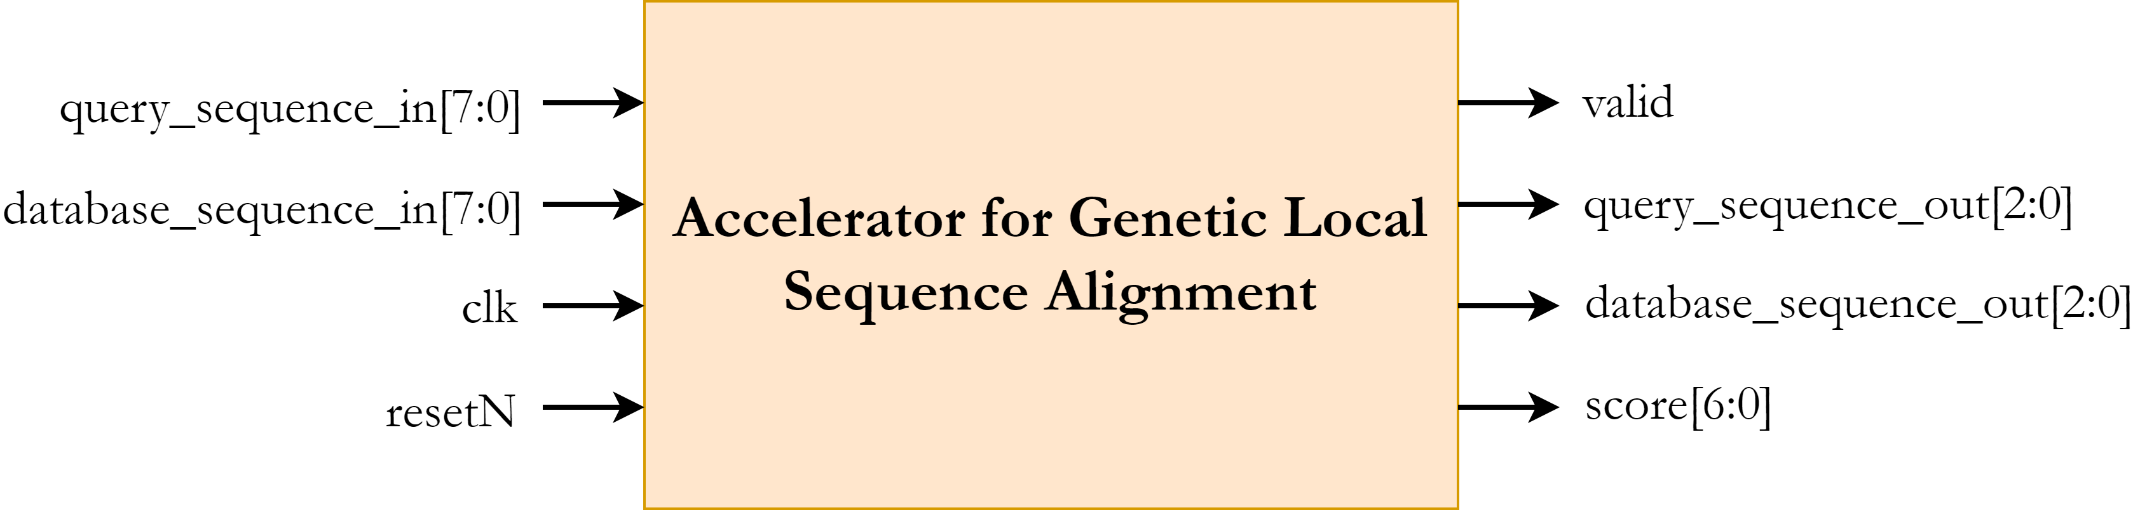
I/O Diagram
18 input pins, 14 output pins
(+8 pins for V_{DD} and V_{SS})
13

Slide 25
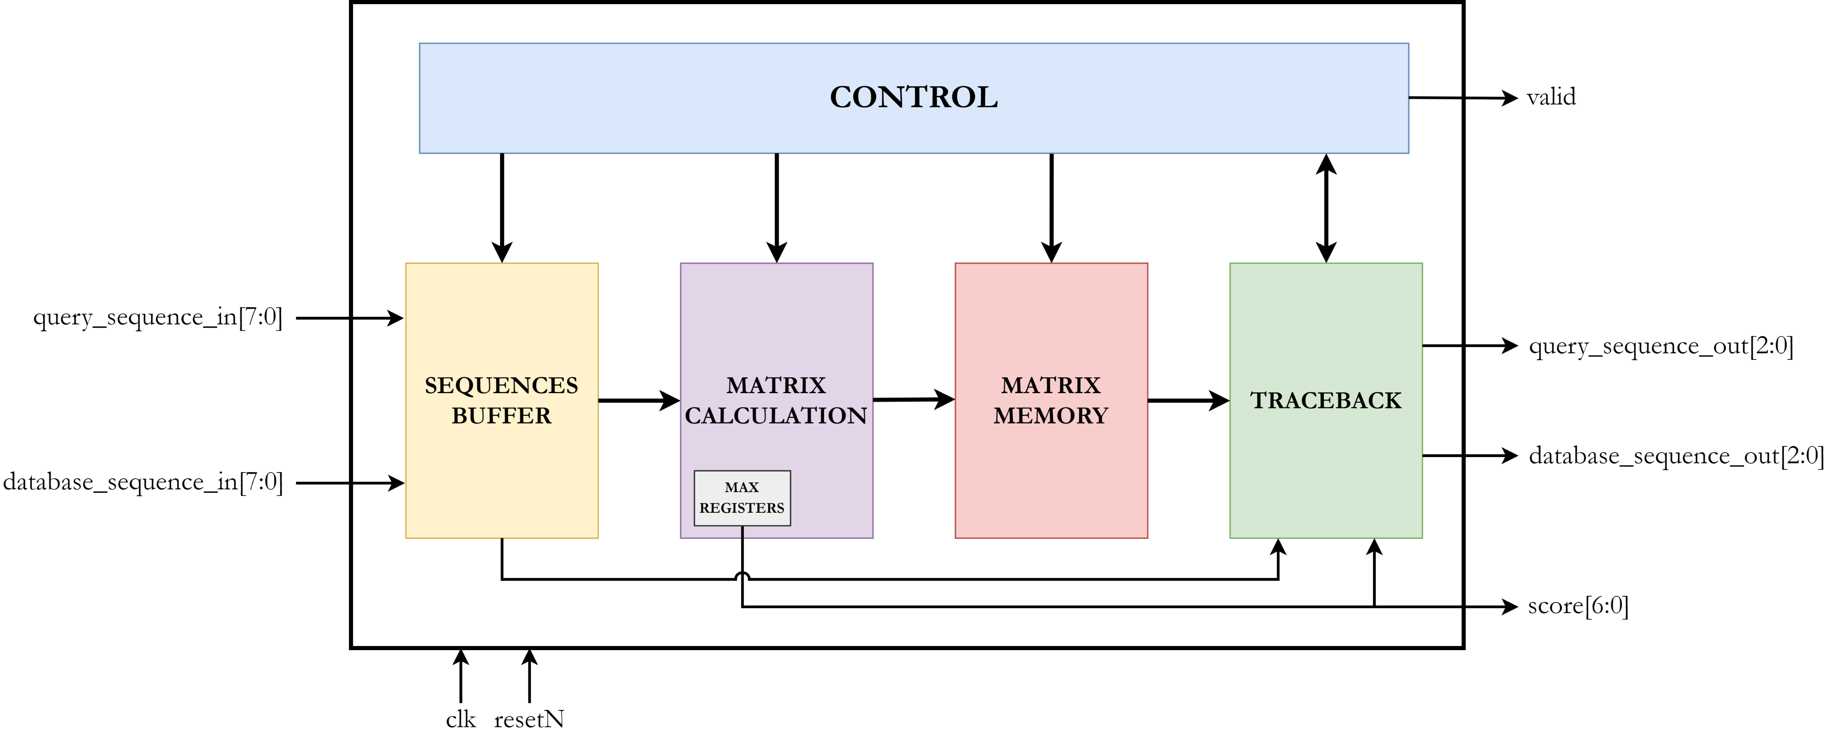
Top Level Architecture
14

Slide 26
Architectural Design
15

Slide 27
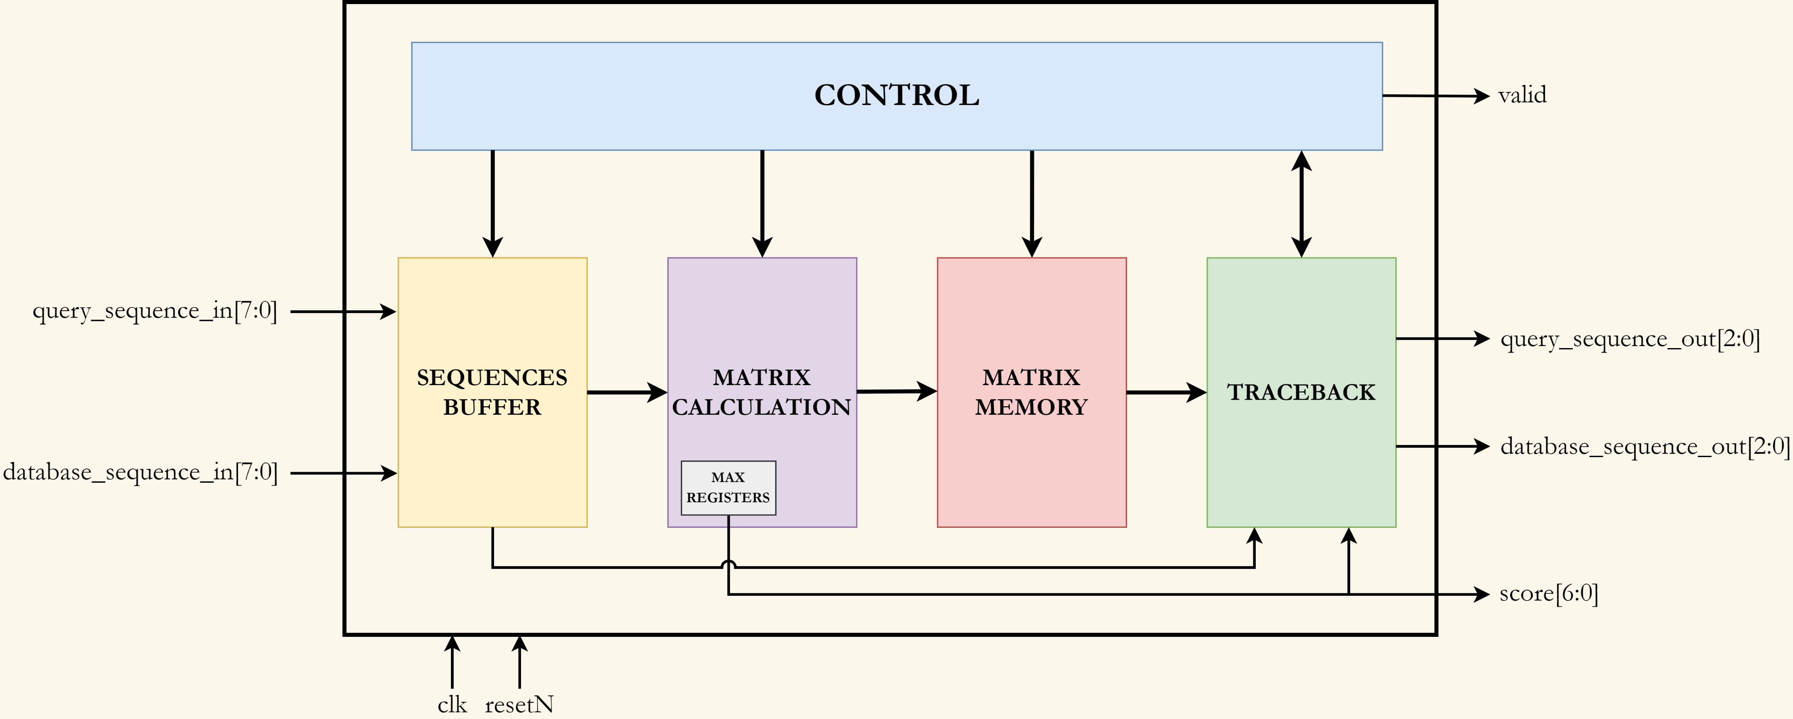
Sequences Buffer
16

Slide 28
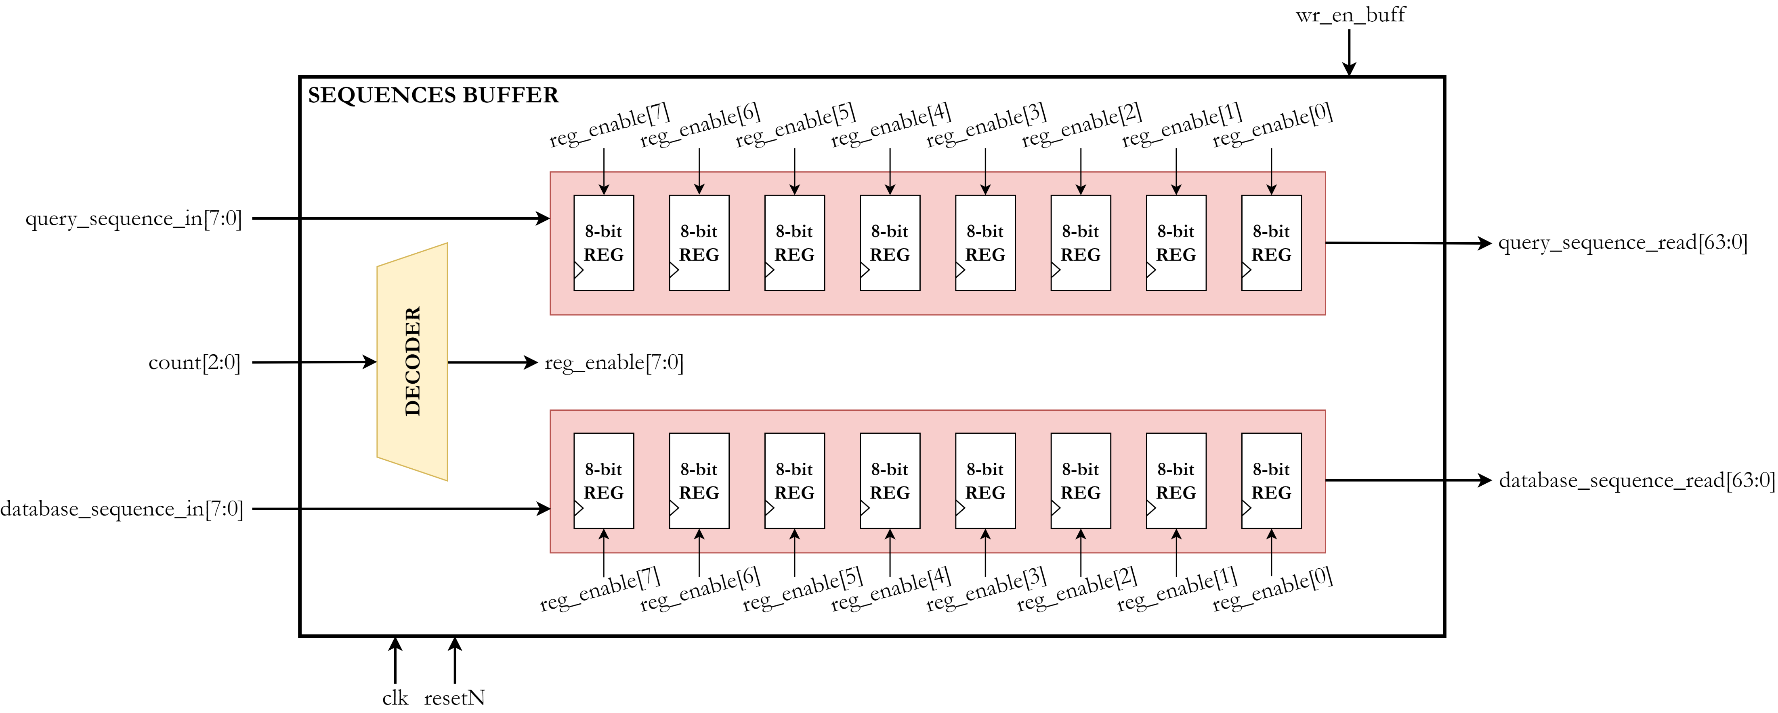
Sequences Buffer
17

Slide 29
Matrix Calculation
18

Slide 30
Score Matrix Computation
T | C | C | T | A | G | C | T | A | T | A | G | G | T | C | A | G | G | T | C | A | T | G | C | C | A | T | A | C | G | G | T |  | S
0 | 0 | 0 | 0 | 0 | 0 | 0 | 0 | 0 | 0 | 0 | 0 | 0 | 0 | 0 | 0 | 0 | 0 | 0 | 0 | 0 | 0 | 0 | 0 | 0 | 0 | 0 | 0 | 0 | 0 | 0 | 0 | 0
 |  |  |  |  |  |  |  |  |  |  |  |  |  |  |  |  |  |  |  |  |  |  |  |  |  |  |  |  |  |  |  | 0 | G
 |  |  |  |  |  |  |  |  |  |  |  |  |  |  |  |  |  |  |  |  |  |  |  |  |  |  |  |  |  |  |  | 0 | T
 |  |  |  |  |  |  |  |  |  |  |  |  |  |  |  |  |  |  |  |  |  |  |  |  |  |  |  |  |  |  |  | 0 | T
 |  |  |  |  |  |  |  |  |  |  |  |  |  |  |  |  |  |  |  |  |  |  |  |  |  |  |  |  |  |  |  | 0 | A
 |  |  |  |  |  |  |  |  |  |  |  |  |  |  |  |  |  |  |  |  |  |  |  |  |  |  |  |  |  |  |  | 0 | C
 |  |  |  |  |  |  |  |  |  |  |  |  |  |  |  |  |  |  |  |  |  |  |  |  |  |  |  |  |  |  |  | 0 | T
 |  |  |  |  |  |  |  |  |  |  |  |  |  |  |  |  |  |  |  |  |  |  |  |  |  |  |  |  |  |  |  | 0 | C
 |  |  |  |  |  |  |  |  |  |  |  |  |  |  |  |  |  |  |  |  |  |  |  |  |  |  |  |  |  |  |  | 0 | A
 |  |  |  |  |  |  |  |  |  |  |  |  |  |  |  |  |  |  |  |  |  |  |  |  |  |  |  |  |  |  |  | 0 | T
 |  |  |  |  |  |  |  |  |  |  |  |  |  |  |  |  |  |  |  |  |  |  |  |  |  |  |  |  |  |  |  | 0 | T
 |  |  |  |  |  |  |  |  |  |  |  |  |  |  |  |  |  |  |  |  |  |  |  |  |  |  |  |  |  |  |  | 0 | A
 |  |  |  |  |  |  |  |  |  |  |  |  |  |  |  |  |  |  |  |  |  |  |  |  |  |  |  |  |  |  |  | 0 | C
 |  |  |  |  |  |  |  |  |  |  |  |  |  |  |  |  |  |  |  |  |  |  |  |  |  |  |  |  |  |  |  | 0 | T
 |  |  |  |  |  |  |  |  |  |  |  |  |  |  |  |  |  |  |  |  |  |  |  |  |  |  |  |  |  |  |  | 0 | C
 |  |  |  |  |  |  |  |  |  |  |  |  |  |  |  |  |  |  |  |  |  |  |  |  |  |  |  |  |  |  |  | 0 | C
 |  |  |  |  |  |  |  |  |  |  |  |  |  |  |  |  |  |  |  |  |  |  |  |  |  |  |  |  |  |  |  | 0 | A
 |  |  |  |  |  |  |  |  |  |  |  |  |  |  |  |  |  |  |  |  |  |  |  |  |  |  |  |  |  |  |  | 0 | T
 |  |  |  |  |  |  |  |  |  |  |  |  |  |  |  |  |  |  |  |  |  |  |  |  |  |  |  |  |  |  |  | 0 | A
 |  |  |  |  |  |  |  |  |  |  |  |  |  |  |  |  |  |  |  |  |  |  |  |  |  |  |  |  |  |  |  | 0 | C
 |  |  |  |  |  |  |  |  |  |  |  |  |  |  |  |  |  |  |  |  |  |  |  |  |  |  |  |  |  |  |  | 0 | G
 |  |  |  |  |  |  |  |  |  |  |  |  |  |  |  |  |  |  |  |  |  |  |  |  |  |  |  |  |  |  |  | 0 | T
 |  |  |  |  |  |  |  |  |  |  |  |  |  |  |  |  |  |  |  |  |  |  |  |  |  |  |  |  |  |  |  | 0 | G
 |  |  |  |  |  |  |  |  |  |  |  |  |  |  |  |  |  |  |  |  |  |  |  |  |  |  |  |  |  |  |  | 0 | A
 |  |  |  |  |  |  |  |  |  |  |  |  |  |  |  |  |  |  |  |  |  |  |  |  |  |  |  |  |  |  |  | 0 | C
 |  |  |  |  |  |  |  |  |  |  |  |  |  |  |  |  |  |  |  |  |  |  |  |  |  |  |  |  |  |  |  | 0 | T
 |  |  |  |  |  |  |  |  |  |  |  |  |  |  |  |  |  |  |  |  |  |  |  |  |  |  |  |  |  |  |  | 0 | T
 |  |  |  |  |  |  |  |  |  |  |  |  |  |  |  |  |  |  |  |  |  |  |  |  |  |  |  |  |  |  |  | 0 | A
 |  |  |  |  |  |  |  |  |  |  |  |  |  |  |  |  |  |  |  |  |  |  |  |  |  |  |  |  |  |  |  | 0 | C
 |  |  |  |  |  |  |  |  |  |  |  |  |  |  |  |  |  |  |  |  |  |  |  |  |  |  |  |  |  |  |  | 0 | A
 |  |  |  |  |  |  |  |  |  |  |  |  |  |  |  |  |  |  |  |  |  |  |  |  |  |  |  |  |  |  |  | 0 | G
 |  |  |  |  |  |  |  |  |  |  |  |  |  |  |  |  |  |  |  |  |  |  |  |  |  |  |  |  |  |  |  | 0 | A
 |  |  |  |  |  |  |  |  |  |  |  |  |  |  |  |  |  |  |  |  |  |  |  |  |  |  |  |  |  |  |  | 0 | A
19

Slide 31
Score Matrix Computation
T | C | C | T | A | G | C | T | A | T | A | G | G | T | C | A | G | G | T | C | A | T | G | C | C | A | T | A | C | G | G | T |  | S
0 | 0 | 0 | 0 | 0 | 0 | 0 | 0 | 0 | 0 | 0 | 0 | 0 | 0 | 0 | 0 | 0 | 0 | 0 | 0 | 0 | 0 | 0 | 0 | 0 | 0 | 0 | 0 | 0 | 0 | 0 | 0 | 0
 |  |  |  |  |  |  |  |  |  |  |  |  |  |  |  |  |  |  |  |  |  |  |  |  |  |  |  |  |  |  |  | 0 | G
 |  |  |  |  |  |  |  |  |  |  |  |  |  |  |  |  |  |  |  |  |  |  |  |  |  |  |  |  |  |  |  | 0 | T
 |  |  |  |  |  |  |  |  |  |  |  |  |  |  |  |  |  |  |  |  |  |  |  |  |  |  |  |  |  |  |  | 0 | T
 |  |  |  |  |  |  |  |  |  |  |  |  |  |  |  |  |  |  |  |  |  |  |  |  |  |  |  |  |  |  |  | 0 | A
 |  |  |  |  |  |  |  |  |  |  |  |  |  |  |  |  |  |  |  |  |  |  |  |  |  |  |  |  |  |  |  | 0 | C
 |  |  |  |  |  |  |  |  |  |  |  |  |  |  |  |  |  |  |  |  |  |  |  |  |  |  |  |  |  |  |  | 0 | T
 |  |  |  |  |  |  |  |  |  |  |  |  |  |  |  |  |  |  |  |  |  |  |  |  |  |  |  |  |  |  |  | 0 | C
 |  |  |  |  |  |  |  |  |  |  |  |  |  |  |  |  |  |  |  |  |  |  |  |  |  |  |  |  |  |  |  | 0 | A
 |  |  |  |  |  |  |  |  |  |  |  |  |  |  |  |  |  |  |  |  |  |  |  |  |  |  |  |  |  |  |  | 0 | T
 |  |  |  |  |  |  |  |  |  |  |  |  |  |  |  |  |  |  |  |  |  |  |  |  |  |  |  |  |  |  |  | 0 | T
 |  |  |  |  |  |  |  |  |  |  |  |  |  |  |  |  |  |  |  |  |  |  |  |  |  |  |  |  |  |  |  | 0 | A
 |  |  |  |  |  |  |  |  |  |  |  |  |  |  |  |  |  |  |  |  |  |  |  |  |  |  |  |  |  |  |  | 0 | C
 |  |  |  |  |  |  |  |  |  |  |  |  |  |  |  |  |  |  |  |  |  |  |  |  |  |  |  |  |  |  |  | 0 | T
 |  |  |  |  |  |  |  |  |  |  |  |  |  |  |  |  |  |  |  |  |  |  |  |  |  |  |  |  |  |  |  | 0 | C
 |  |  |  |  |  |  |  |  |  |  |  |  |  |  |  |  |  |  |  |  |  |  |  |  |  |  |  |  |  |  |  | 0 | C
 |  |  |  |  |  |  |  |  |  |  |  |  |  |  |  |  |  |  |  |  |  |  |  |  |  |  |  |  |  |  |  | 0 | A
 |  |  |  |  |  |  |  |  |  |  |  |  |  |  |  |  |  |  |  |  |  |  |  |  |  |  |  |  |  |  |  | 0 | T
 |  |  |  |  |  |  |  |  |  |  |  |  |  |  |  |  |  |  |  |  |  |  |  |  |  |  |  |  |  |  |  | 0 | A
 |  |  |  |  |  |  |  |  |  |  |  |  |  |  |  |  |  |  |  |  |  |  |  |  |  |  |  |  |  |  |  | 0 | C
 |  |  |  |  |  |  |  |  |  |  |  |  |  |  |  |  |  |  |  |  |  |  |  |  |  |  |  |  |  |  |  | 0 | G
 |  |  |  |  |  |  |  |  |  |  |  |  |  |  |  |  |  |  |  |  |  |  |  |  |  |  |  |  |  |  |  | 0 | T
 |  |  |  |  |  |  |  |  |  |  |  |  |  |  |  |  |  |  |  |  |  |  |  |  |  |  |  |  |  |  |  | 0 | G
 |  |  |  |  |  |  |  |  |  |  |  |  |  |  |  |  |  |  |  |  |  |  |  |  |  |  |  |  |  |  |  | 0 | A
 |  |  |  |  |  |  |  |  |  |  |  |  |  |  |  |  |  |  |  |  |  |  |  |  |  |  |  |  |  |  |  | 0 | C
 |  |  |  |  |  |  |  |  |  |  |  |  |  |  |  |  |  |  |  |  |  |  |  |  |  |  |  |  |  |  |  | 0 | T
 |  |  |  |  |  |  |  |  |  |  |  |  |  |  |  |  |  |  |  |  |  |  |  |  |  |  |  |  |  |  |  | 0 | T
 |  |  |  |  |  |  |  |  |  |  |  |  |  |  |  |  |  |  |  |  |  |  |  |  |  |  |  |  |  |  |  | 0 | A
 |  |  |  |  |  |  |  |  |  |  |  |  |  |  |  |  |  |  |  |  |  |  |  |  |  |  |  |  |  |  |  | 0 | C
 |  |  |  |  |  |  |  |  |  |  |  |  |  |  |  |  |  |  |  |  |  |  |  |  |  |  |  |  |  |  |  | 0 | A
 |  |  |  |  |  |  |  |  |  |  |  |  |  |  |  |  |  |  |  |  |  |  |  |  |  |  |  |  |  |  |  | 0 | G
 |  |  |  |  |  |  |  |  |  |  |  |  |  |  |  |  |  |  |  |  |  |  |  |  |  |  |  |  |  |  |  | 0 | A
 |  |  |  |  |  |  |  |  |  |  |  |  |  |  |  |  |  |  |  |  |  |  |  |  |  |  |  |  |  |  |  | 0 | A
19

Slide 32
Score Matrix Computation
T | C | C | T | A | G | C | T | A | T | A | G | G | T | C | A | G | G | T | C | A | T | G | C | C | A | T | A | C | G | G | T |  | S
0 | 0 | 0 | 0 | 0 | 0 | 0 | 0 | 0 | 0 | 0 | 0 | 0 | 0 | 0 | 0 | 0 | 0 | 0 | 0 | 0 | 0 | 0 | 0 | 0 | 0 | 0 | 0 | 0 | 0 | 0 | 0 | 0
 |  |  |  |  |  |  |  |  |  |  |  |  |  |  |  |  |  |  |  |  |  |  |  |  |  |  |  |  |  |  |  | 0 | G
 |  |  |  |  |  |  |  |  |  |  |  |  |  |  |  |  |  |  |  |  |  |  |  |  |  |  |  |  |  |  |  | 0 | T
 |  |  |  |  |  |  |  |  |  |  |  |  |  |  |  |  |  |  |  |  |  |  |  |  |  |  |  |  |  |  |  | 0 | T
 |  |  |  |  |  |  |  |  |  |  |  |  |  |  |  |  |  |  |  |  |  |  |  |  |  |  |  |  |  |  |  | 0 | A
 |  |  |  |  |  |  |  |  |  |  |  |  |  |  |  |  |  |  |  |  |  |  |  |  |  |  |  |  |  |  |  | 0 | C
 |  |  |  |  |  |  |  |  |  |  |  |  |  |  |  |  |  |  |  |  |  |  |  |  |  |  |  |  |  |  |  | 0 | T
 |  |  |  |  |  |  |  |  |  |  |  |  |  |  |  |  |  |  |  |  |  |  |  |  |  |  |  |  |  |  |  | 0 | C
 |  |  |  |  |  |  |  |  |  |  |  |  |  |  |  |  |  |  |  |  |  |  |  |  |  |  |  |  |  |  |  | 0 | A
 |  |  |  |  |  |  |  |  |  |  |  |  |  |  |  |  |  |  |  |  |  |  |  |  |  |  |  |  |  |  |  | 0 | T
 |  |  |  |  |  |  |  |  |  |  |  |  |  |  |  |  |  |  |  |  |  |  |  |  |  |  |  |  |  |  |  | 0 | T
 |  |  |  |  |  |  |  |  |  |  |  |  |  |  |  |  |  |  |  |  |  |  |  |  |  |  |  |  |  |  |  | 0 | A
 |  |  |  |  |  |  |  |  |  |  |  |  |  |  |  |  |  |  |  |  |  |  |  |  |  |  |  |  |  |  |  | 0 | C
 |  |  |  |  |  |  |  |  |  |  |  |  |  |  |  |  |  |  |  |  |  |  |  |  |  |  |  |  |  |  |  | 0 | T
 |  |  |  |  |  |  |  |  |  |  |  |  |  |  |  |  |  |  |  |  |  |  |  |  |  |  |  |  |  |  |  | 0 | C
 |  |  |  |  |  |  |  |  |  |  |  |  |  |  |  |  |  |  |  |  |  |  |  |  |  |  |  |  |  |  |  | 0 | C
 |  |  |  |  |  |  |  |  |  |  |  |  |  |  |  |  |  |  |  |  |  |  |  |  |  |  |  |  |  |  |  | 0 | A
 |  |  |  |  |  |  |  |  |  |  |  |  |  |  |  |  |  |  |  |  |  |  |  |  |  |  |  |  |  |  |  | 0 | T
 |  |  |  |  |  |  |  |  |  |  |  |  |  |  |  |  |  |  |  |  |  |  |  |  |  |  |  |  |  |  |  | 0 | A
 |  |  |  |  |  |  |  |  |  |  |  |  |  |  |  |  |  |  |  |  |  |  |  |  |  |  |  |  |  |  |  | 0 | C
 |  |  |  |  |  |  |  |  |  |  |  |  |  |  |  |  |  |  |  |  |  |  |  |  |  |  |  |  |  |  |  | 0 | G
 |  |  |  |  |  |  |  |  |  |  |  |  |  |  |  |  |  |  |  |  |  |  |  |  |  |  |  |  |  |  |  | 0 | T
 |  |  |  |  |  |  |  |  |  |  |  |  |  |  |  |  |  |  |  |  |  |  |  |  |  |  |  |  |  |  |  | 0 | G
 |  |  |  |  |  |  |  |  |  |  |  |  |  |  |  |  |  |  |  |  |  |  |  |  |  |  |  |  |  |  |  | 0 | A
 |  |  |  |  |  |  |  |  |  |  |  |  |  |  |  |  |  |  |  |  |  |  |  |  |  |  |  |  |  |  |  | 0 | C
 |  |  |  |  |  |  |  |  |  |  |  |  |  |  |  |  |  |  |  |  |  |  |  |  |  |  |  |  |  |  |  | 0 | T
 |  |  |  |  |  |  |  |  |  |  |  |  |  |  |  |  |  |  |  |  |  |  |  |  |  |  |  |  |  |  |  | 0 | T
 |  |  |  |  |  |  |  |  |  |  |  |  |  |  |  |  |  |  |  |  |  |  |  |  |  |  |  |  |  |  |  | 0 | A
 |  |  |  |  |  |  |  |  |  |  |  |  |  |  |  |  |  |  |  |  |  |  |  |  |  |  |  |  |  |  |  | 0 | C
 |  |  |  |  |  |  |  |  |  |  |  |  |  |  |  |  |  |  |  |  |  |  |  |  |  |  |  |  |  |  |  | 0 | A
 |  |  |  |  |  |  |  |  |  |  |  |  |  |  |  |  |  |  |  |  |  |  |  |  |  |  |  |  |  |  |  | 0 | G
 |  |  |  |  |  |  |  |  |  |  |  |  |  |  |  |  |  |  |  |  |  |  |  |  |  |  |  |  |  |  |  | 0 | A
 |  |  |  |  |  |  |  |  |  |  |  |  |  |  |  |  |  |  |  |  |  |  |  |  |  |  |  |  |  |  |  | 0 | A
19

Slide 33
Score Matrix Computation
T | C | C | T | A | G | C | T | A | T | A | G | G | T | C | A | G | G | T | C | A | T | G | C | C | A | T | A | C | G | G | T |  | S
0 | 0 | 0 | 0 | 0 | 0 | 0 | 0 | 0 | 0 | 0 | 0 | 0 | 0 | 0 | 0 | 0 | 0 | 0 | 0 | 0 | 0 | 0 | 0 | 0 | 0 | 0 | 0 | 0 | 0 | 0 | 0 | 0
 |  |  |  |  |  |  |  |  |  |  |  |  |  |  |  |  |  |  |  |  |  |  |  |  |  |  |  |  |  |  |  | 0 | G
 |  |  |  |  |  |  |  |  |  |  |  |  |  |  |  |  |  |  |  |  |  |  |  |  |  |  |  |  |  |  |  | 0 | T
 |  |  |  |  |  |  |  |  |  |  |  |  |  |  |  |  |  |  |  |  |  |  |  |  |  |  |  |  |  |  |  | 0 | T
 |  |  |  |  |  |  |  |  |  |  |  |  |  |  |  |  |  |  |  |  |  |  |  |  |  |  |  |  |  |  |  | 0 | A
 |  |  |  |  |  |  |  |  |  |  |  |  |  |  |  |  |  |  |  |  |  |  |  |  |  |  |  |  |  |  |  | 0 | C
 |  |  |  |  |  |  |  |  |  |  |  |  |  |  |  |  |  |  |  |  |  |  |  |  |  |  |  |  |  |  |  | 0 | T
 |  |  |  |  |  |  |  |  |  |  |  |  |  |  |  |  |  |  |  |  |  |  |  |  |  |  |  |  |  |  |  | 0 | C
 |  |  |  |  |  |  |  |  |  |  |  |  |  |  |  |  |  |  |  |  |  |  |  |  |  |  |  |  |  |  |  | 0 | A
 |  |  |  |  |  |  |  |  |  |  |  |  |  |  |  |  |  |  |  |  |  |  |  |  |  |  |  |  |  |  |  | 0 | T
 |  |  |  |  |  |  |  |  |  |  |  |  |  |  |  |  |  |  |  |  |  |  |  |  |  |  |  |  |  |  |  | 0 | T
 |  |  |  |  |  |  |  |  |  |  |  |  |  |  |  |  |  |  |  |  |  |  |  |  |  |  |  |  |  |  |  | 0 | A
 |  |  |  |  |  |  |  |  |  |  |  |  |  |  |  |  |  |  |  |  |  |  |  |  |  |  |  |  |  |  |  | 0 | C
 |  |  |  |  |  |  |  |  |  |  |  |  |  |  |  |  |  |  |  |  |  |  |  |  |  |  |  |  |  |  |  | 0 | T
 |  |  |  |  |  |  |  |  |  |  |  |  |  |  |  |  |  |  |  |  |  |  |  |  |  |  |  |  |  |  |  | 0 | C
 |  |  |  |  |  |  |  |  |  |  |  |  |  |  |  |  |  |  |  |  |  |  |  |  |  |  |  |  |  |  |  | 0 | C
 |  |  |  |  |  |  |  |  |  |  |  |  |  |  |  |  |  |  |  |  |  |  |  |  |  |  |  |  |  |  |  | 0 | A
 |  |  |  |  |  |  |  |  |  |  |  |  |  |  |  |  |  |  |  |  |  |  |  |  |  |  |  |  |  |  |  | 0 | T
 |  |  |  |  |  |  |  |  |  |  |  |  |  |  |  |  |  |  |  |  |  |  |  |  |  |  |  |  |  |  |  | 0 | A
 |  |  |  |  |  |  |  |  |  |  |  |  |  |  |  |  |  |  |  |  |  |  |  |  |  |  |  |  |  |  |  | 0 | C
 |  |  |  |  |  |  |  |  |  |  |  |  |  |  |  |  |  |  |  |  |  |  |  |  |  |  |  |  |  |  |  | 0 | G
 |  |  |  |  |  |  |  |  |  |  |  |  |  |  |  |  |  |  |  |  |  |  |  |  |  |  |  |  |  |  |  | 0 | T
 |  |  |  |  |  |  |  |  |  |  |  |  |  |  |  |  |  |  |  |  |  |  |  |  |  |  |  |  |  |  |  | 0 | G
 |  |  |  |  |  |  |  |  |  |  |  |  |  |  |  |  |  |  |  |  |  |  |  |  |  |  |  |  |  |  |  | 0 | A
 |  |  |  |  |  |  |  |  |  |  |  |  |  |  |  |  |  |  |  |  |  |  |  |  |  |  |  |  |  |  |  | 0 | C
 |  |  |  |  |  |  |  |  |  |  |  |  |  |  |  |  |  |  |  |  |  |  |  |  |  |  |  |  |  |  |  | 0 | T
 |  |  |  |  |  |  |  |  |  |  |  |  |  |  |  |  |  |  |  |  |  |  |  |  |  |  |  |  |  |  |  | 0 | T
 |  |  |  |  |  |  |  |  |  |  |  |  |  |  |  |  |  |  |  |  |  |  |  |  |  |  |  |  |  |  |  | 0 | A
 |  |  |  |  |  |  |  |  |  |  |  |  |  |  |  |  |  |  |  |  |  |  |  |  |  |  |  |  |  |  |  | 0 | C
 |  |  |  |  |  |  |  |  |  |  |  |  |  |  |  |  |  |  |  |  |  |  |  |  |  |  |  |  |  |  |  | 0 | A
 |  |  |  |  |  |  |  |  |  |  |  |  |  |  |  |  |  |  |  |  |  |  |  |  |  |  |  |  |  |  |  | 0 | G
 |  |  |  |  |  |  |  |  |  |  |  |  |  |  |  |  |  |  |  |  |  |  |  |  |  |  |  |  |  |  |  | 0 | A
 |  |  |  |  |  |  |  |  |  |  |  |  |  |  |  |  |  |  |  |  |  |  |  |  |  |  |  |  |  |  |  | 0 | A
19

Slide 34
Score Matrix Computation
T | C | C | T | A | G | C | T | A | T | A | G | G | T | C | A | G | G | T | C | A | T | G | C | C | A | T | A | C | G | G | T |  | S
0 | 0 | 0 | 0 | 0 | 0 | 0 | 0 | 0 | 0 | 0 | 0 | 0 | 0 | 0 | 0 | 0 | 0 | 0 | 0 | 0 | 0 | 0 | 0 | 0 | 0 | 0 | 0 | 0 | 0 | 0 | 0 | 0
 |  |  |  |  |  |  |  |  |  |  |  |  |  |  |  |  |  |  |  |  |  |  |  |  |  |  |  |  |  |  |  | 0 | G
 |  |  |  |  |  |  |  |  |  |  |  |  |  |  |  |  |  |  |  |  |  |  |  |  |  |  |  |  |  |  |  | 0 | T
 |  |  |  |  |  |  |  |  |  |  |  |  |  |  |  |  |  |  |  |  |  |  |  |  |  |  |  |  |  |  |  | 0 | T
 |  |  |  |  |  |  |  |  |  |  |  |  |  |  |  |  |  |  |  |  |  |  |  |  |  |  |  |  |  |  |  | 0 | A
 |  |  |  |  |  |  |  |  |  |  |  |  |  |  |  |  |  |  |  |  |  |  |  |  |  |  |  |  |  |  |  | 0 | C
 |  |  |  |  |  |  |  |  |  |  |  |  |  |  |  |  |  |  |  |  |  |  |  |  |  |  |  |  |  |  |  | 0 | T
 |  |  |  |  |  |  |  |  |  |  |  |  |  |  |  |  |  |  |  |  |  |  |  |  |  |  |  |  |  |  |  | 0 | C
 |  |  |  |  |  |  |  |  |  |  |  |  |  |  |  |  |  |  |  |  |  |  |  |  |  |  |  |  |  |  |  | 0 | A
 |  |  |  |  |  |  |  |  |  |  |  |  |  |  |  |  |  |  |  |  |  |  |  |  |  |  |  |  |  |  |  | 0 | T
 |  |  |  |  |  |  |  |  |  |  |  |  |  |  |  |  |  |  |  |  |  |  |  |  |  |  |  |  |  |  |  | 0 | T
 |  |  |  |  |  |  |  |  |  |  |  |  |  |  |  |  |  |  |  |  |  |  |  |  |  |  |  |  |  |  |  | 0 | A
 |  |  |  |  |  |  |  |  |  |  |  |  |  |  |  |  |  |  |  |  |  |  |  |  |  |  |  |  |  |  |  | 0 | C
 |  |  |  |  |  |  |  |  |  |  |  |  |  |  |  |  |  |  |  |  |  |  |  |  |  |  |  |  |  |  |  | 0 | T
 |  |  |  |  |  |  |  |  |  |  |  |  |  |  |  |  |  |  |  |  |  |  |  |  |  |  |  |  |  |  |  | 0 | C
 |  |  |  |  |  |  |  |  |  |  |  |  |  |  |  |  |  |  |  |  |  |  |  |  |  |  |  |  |  |  |  | 0 | C
 |  |  |  |  |  |  |  |  |  |  |  |  |  |  |  |  |  |  |  |  |  |  |  |  |  |  |  |  |  |  |  | 0 | A
 |  |  |  |  |  |  |  |  |  |  |  |  |  |  |  |  |  |  |  |  |  |  |  |  |  |  |  |  |  |  |  | 0 | T
 |  |  |  |  |  |  |  |  |  |  |  |  |  |  |  |  |  |  |  |  |  |  |  |  |  |  |  |  |  |  |  | 0 | A
 |  |  |  |  |  |  |  |  |  |  |  |  |  |  |  |  |  |  |  |  |  |  |  |  |  |  |  |  |  |  |  | 0 | C
 |  |  |  |  |  |  |  |  |  |  |  |  |  |  |  |  |  |  |  |  |  |  |  |  |  |  |  |  |  |  |  | 0 | G
 |  |  |  |  |  |  |  |  |  |  |  |  |  |  |  |  |  |  |  |  |  |  |  |  |  |  |  |  |  |  |  | 0 | T
 |  |  |  |  |  |  |  |  |  |  |  |  |  |  |  |  |  |  |  |  |  |  |  |  |  |  |  |  |  |  |  | 0 | G
 |  |  |  |  |  |  |  |  |  |  |  |  |  |  |  |  |  |  |  |  |  |  |  |  |  |  |  |  |  |  |  | 0 | A
 |  |  |  |  |  |  |  |  |  |  |  |  |  |  |  |  |  |  |  |  |  |  |  |  |  |  |  |  |  |  |  | 0 | C
 |  |  |  |  |  |  |  |  |  |  |  |  |  |  |  |  |  |  |  |  |  |  |  |  |  |  |  |  |  |  |  | 0 | T
 |  |  |  |  |  |  |  |  |  |  |  |  |  |  |  |  |  |  |  |  |  |  |  |  |  |  |  |  |  |  |  | 0 | T
 |  |  |  |  |  |  |  |  |  |  |  |  |  |  |  |  |  |  |  |  |  |  |  |  |  |  |  |  |  |  |  | 0 | A
 |  |  |  |  |  |  |  |  |  |  |  |  |  |  |  |  |  |  |  |  |  |  |  |  |  |  |  |  |  |  |  | 0 | C
 |  |  |  |  |  |  |  |  |  |  |  |  |  |  |  |  |  |  |  |  |  |  |  |  |  |  |  |  |  |  |  | 0 | A
 |  |  |  |  |  |  |  |  |  |  |  |  |  |  |  |  |  |  |  |  |  |  |  |  |  |  |  |  |  |  |  | 0 | G
 |  |  |  |  |  |  |  |  |  |  |  |  |  |  |  |  |  |  |  |  |  |  |  |  |  |  |  |  |  |  |  | 0 | A
 |  |  |  |  |  |  |  |  |  |  |  |  |  |  |  |  |  |  |  |  |  |  |  |  |  |  |  |  |  |  |  | 0 | A
19

Slide 35
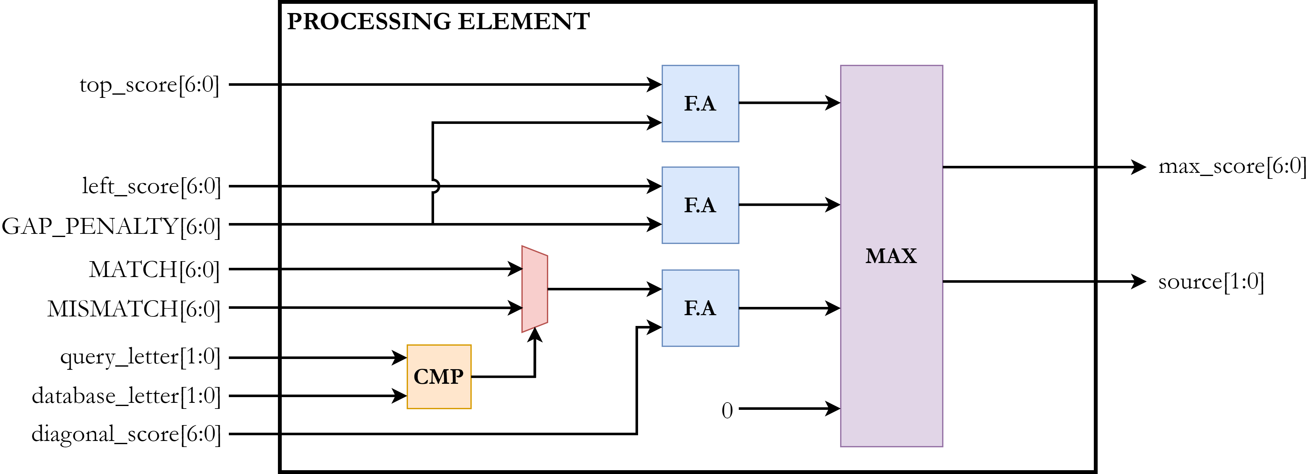
Processing Element
20

Slide 36
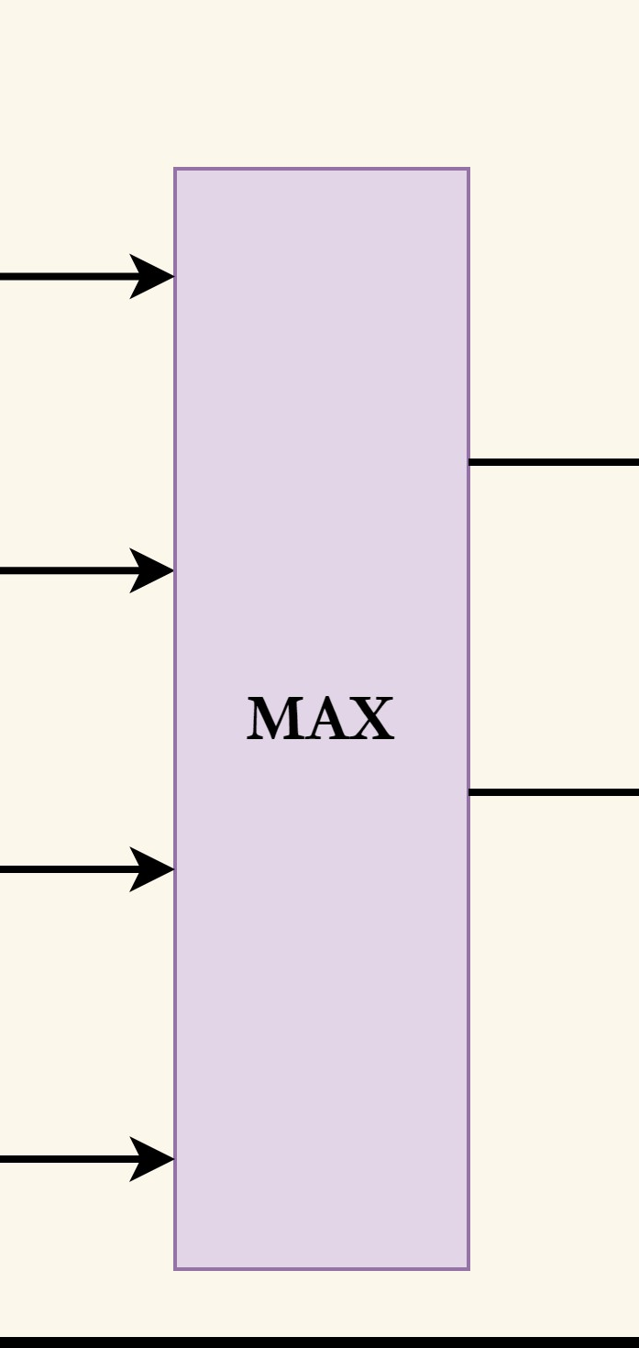
Processing Element
21

Slide 37
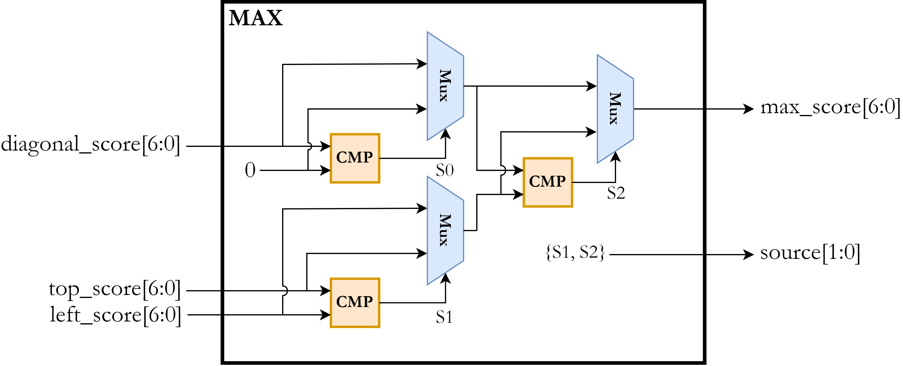
Max Unit
22

Slide 38
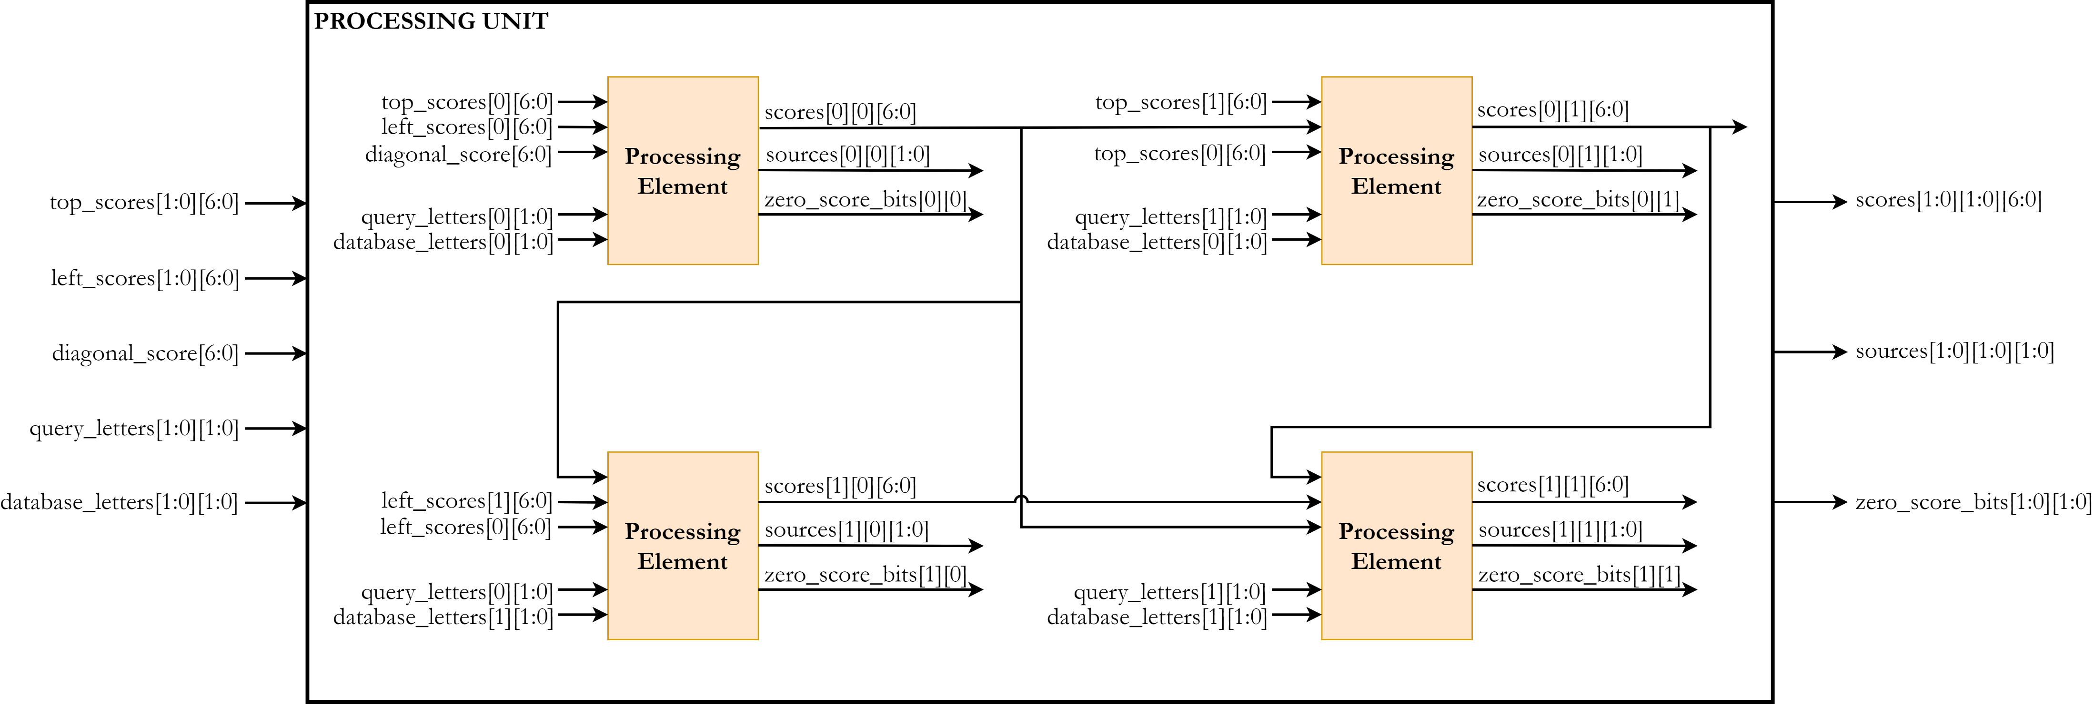
Processing Unit
23

Slide 39
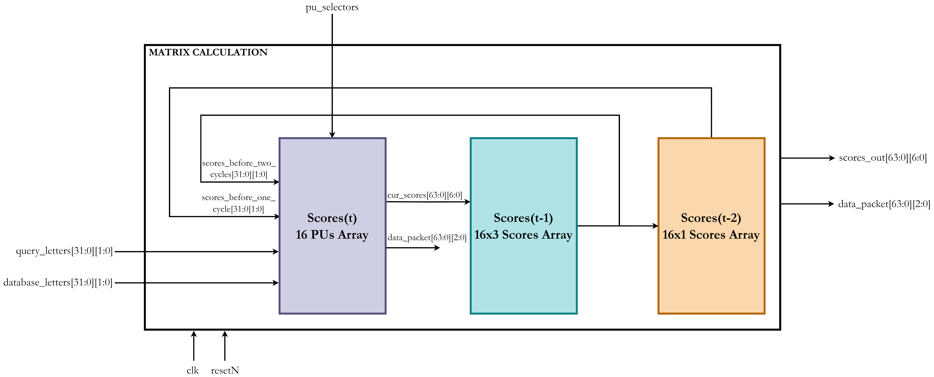
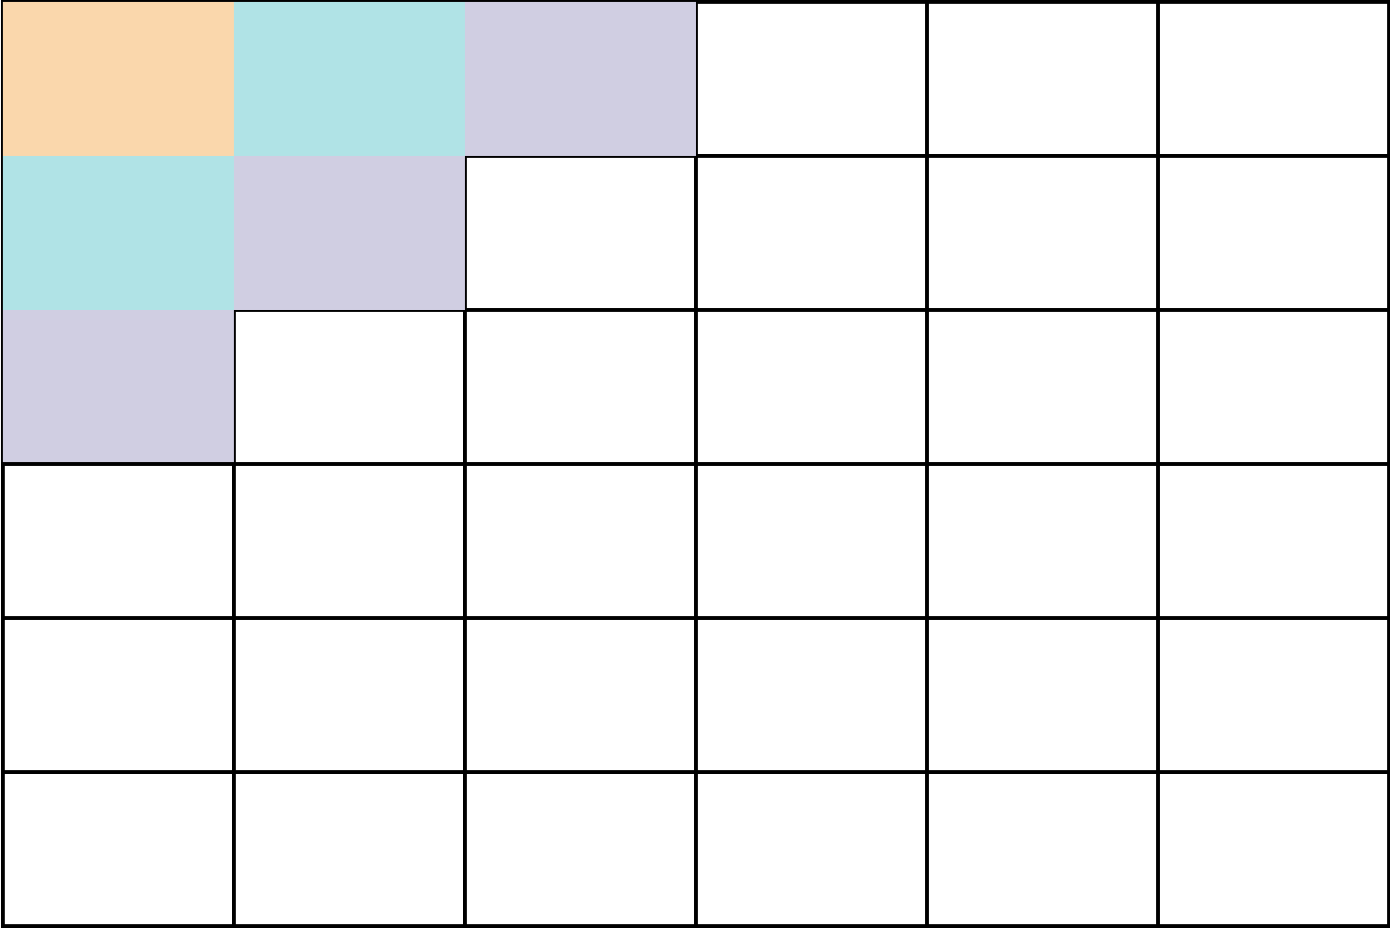
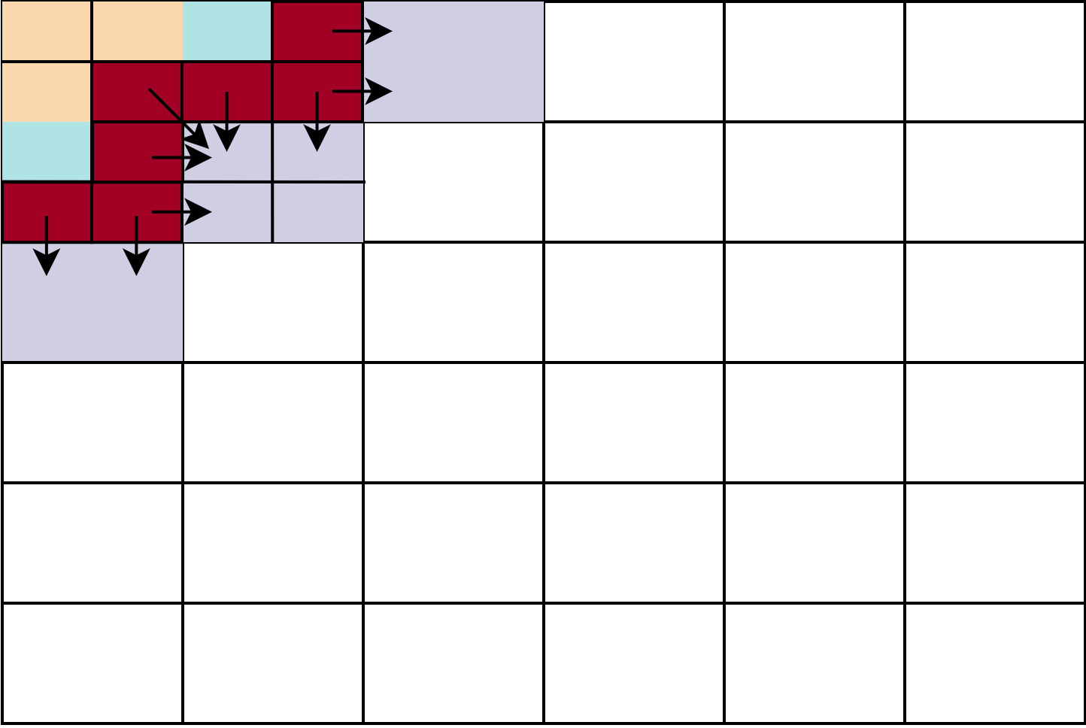
Score Matrix Computation
24

Slide 40
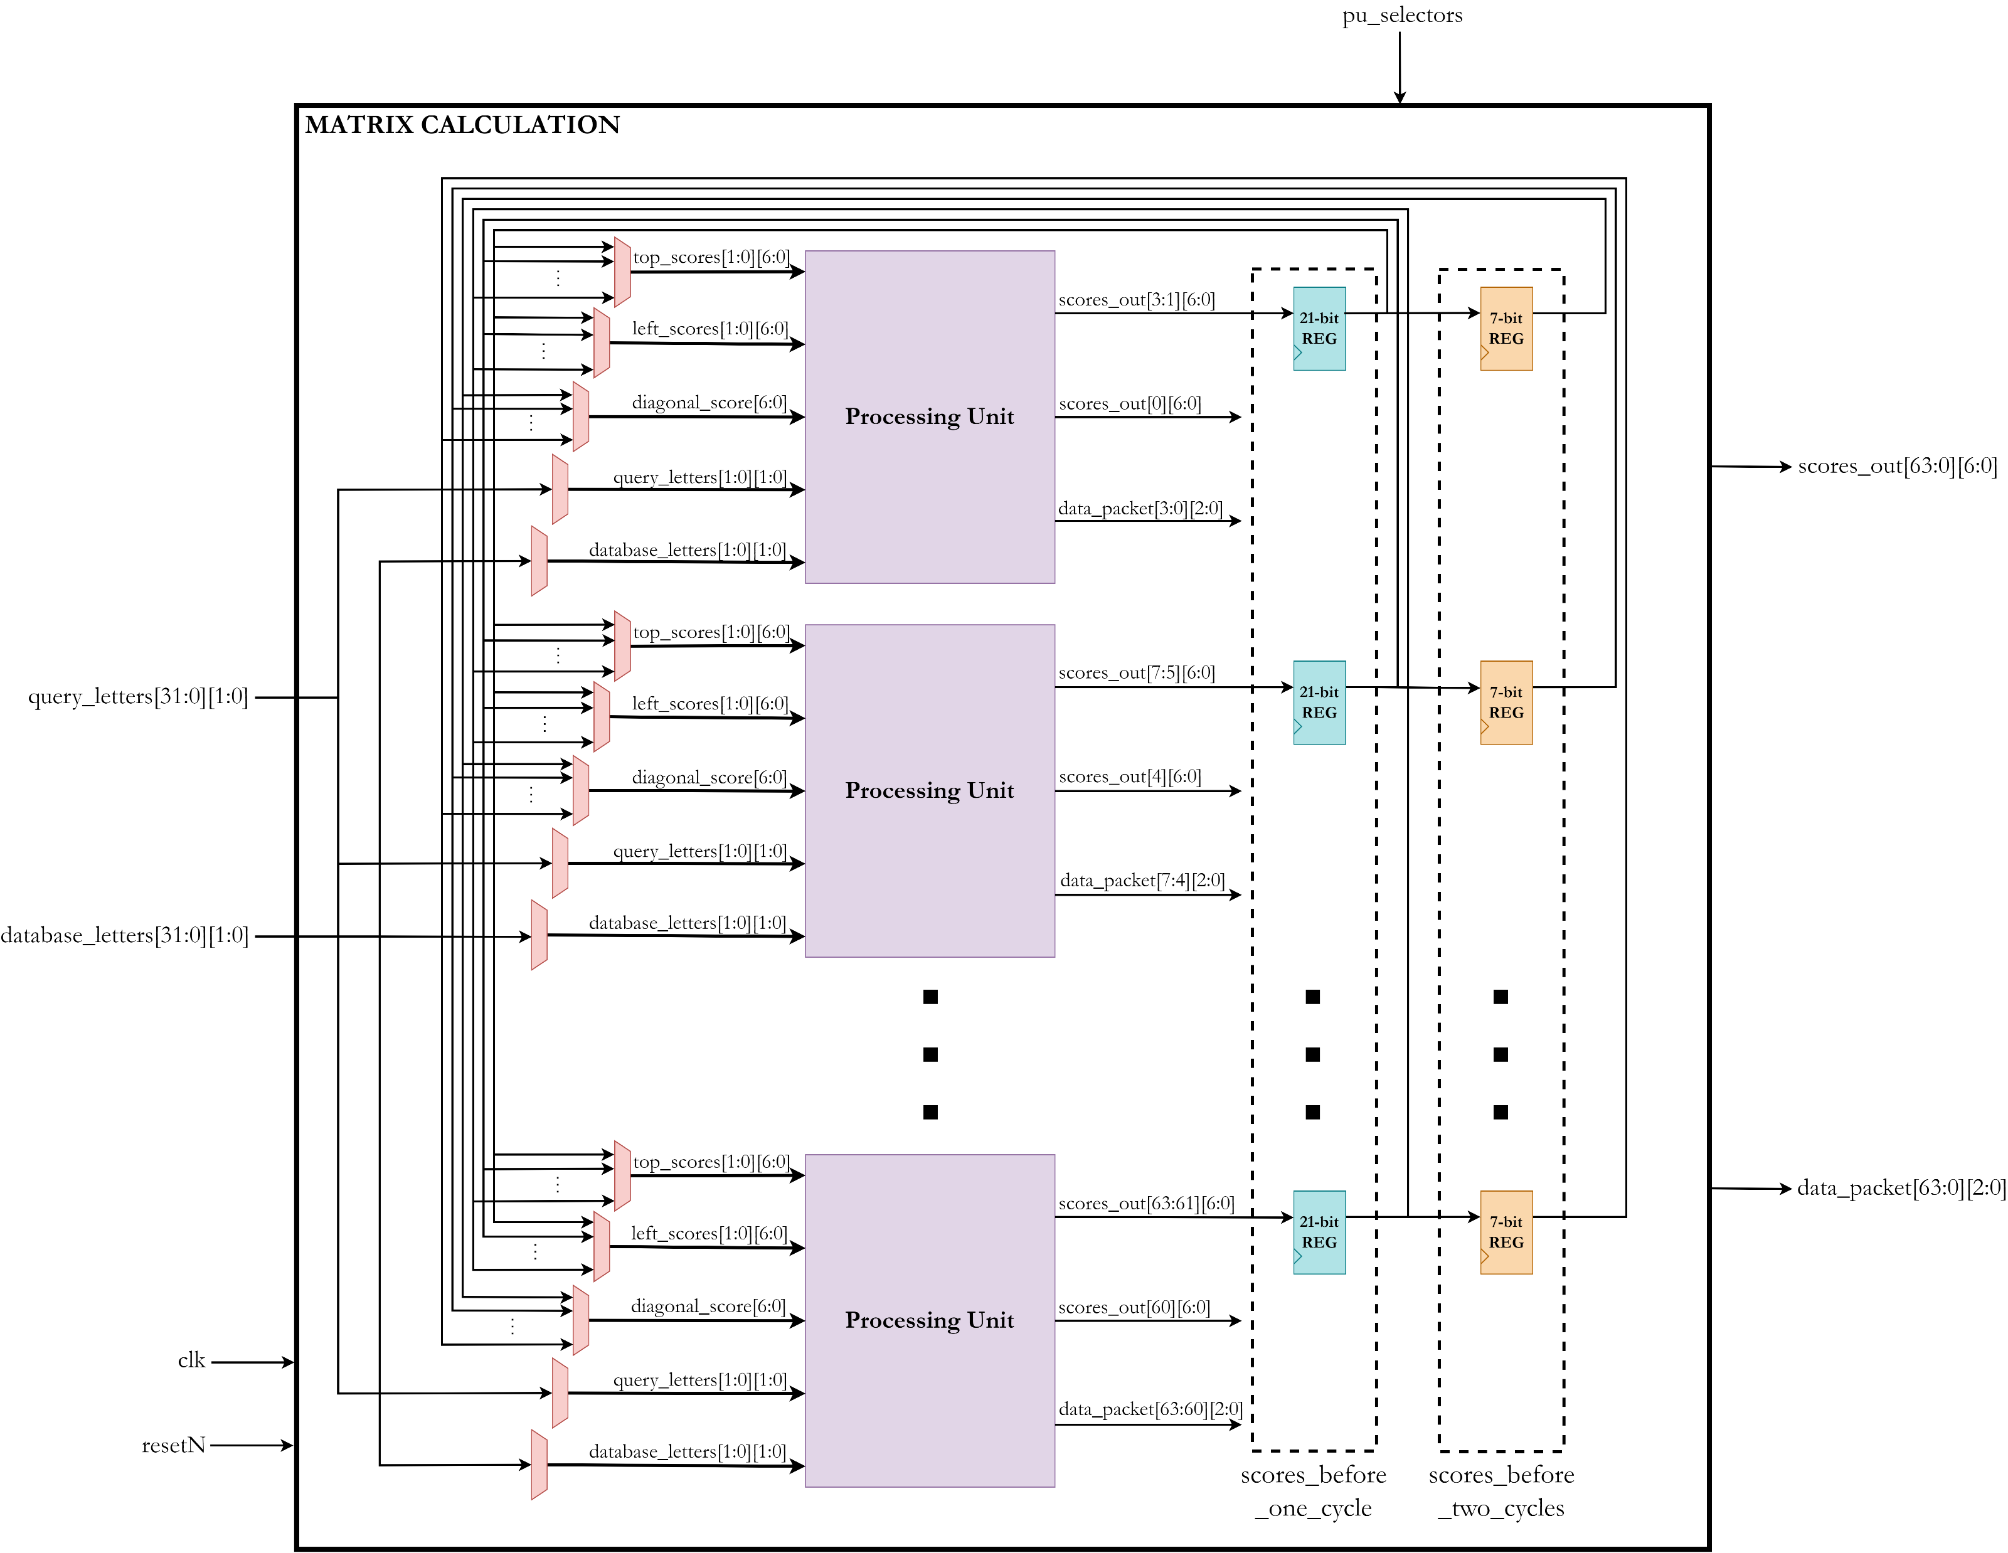
Score Matrix Computation
25

Slide 41
Max Registers
26

Slide 42
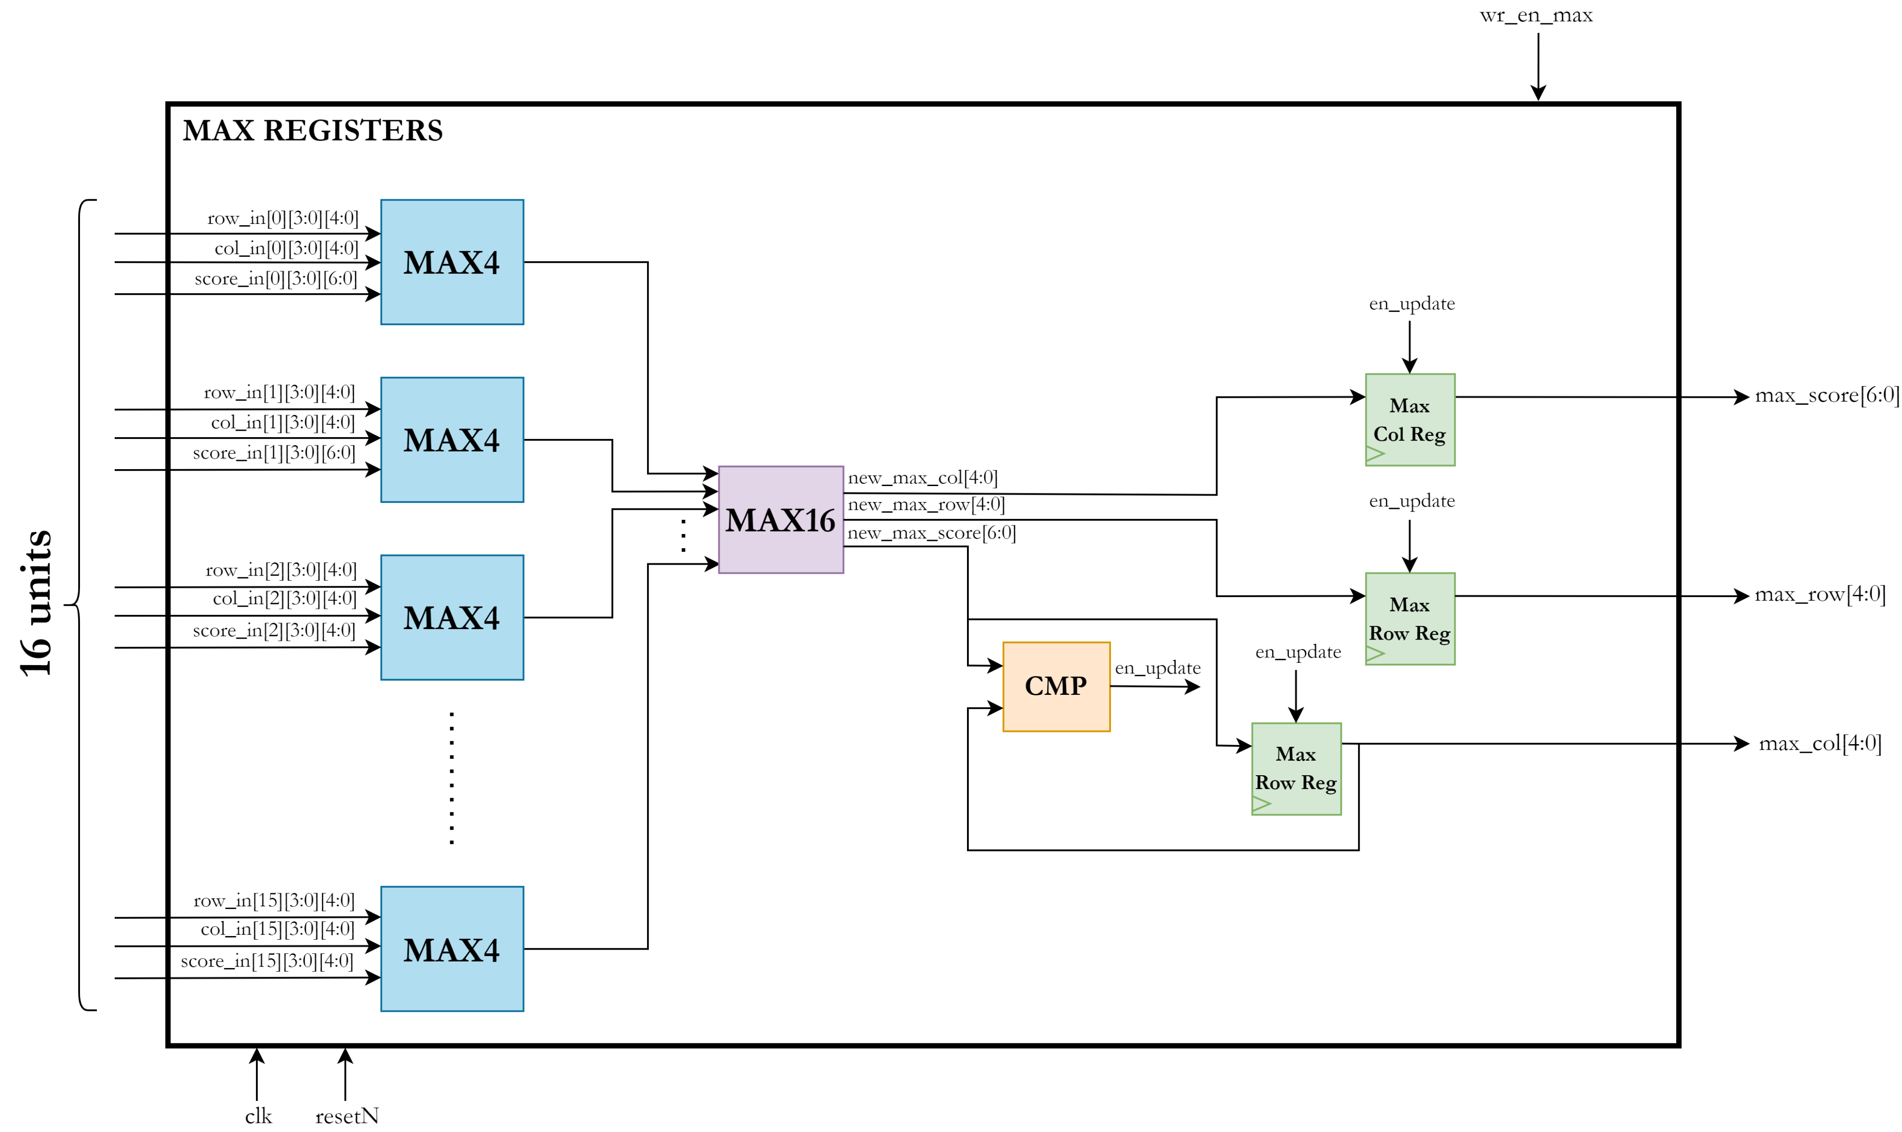
Max Registers
27

Slide 43
Matrix Memory
28

Slide 44
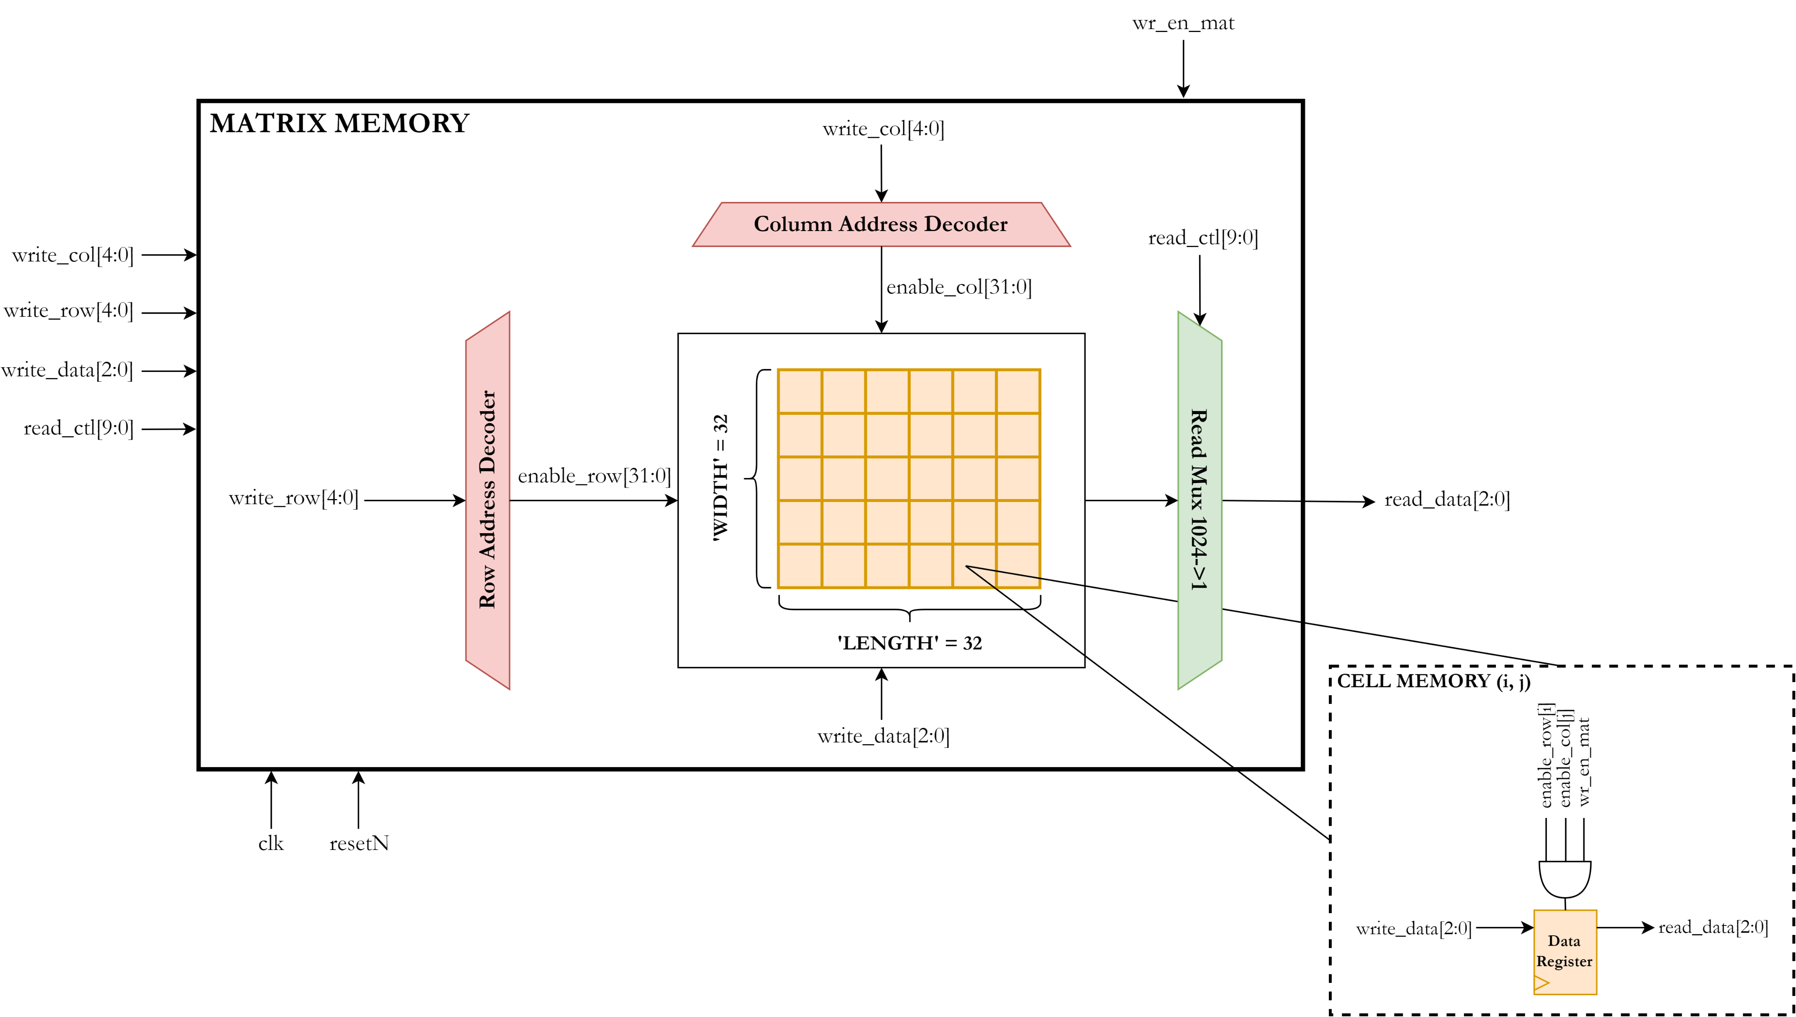
Matrix Memory
29

Slide 45
Traceback
30

Slide 46
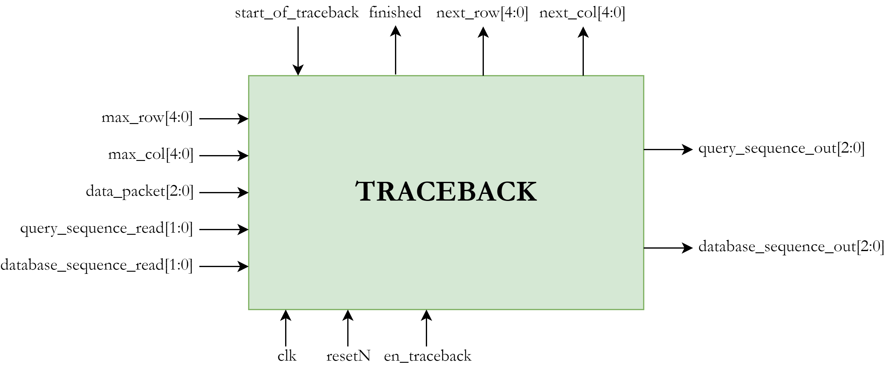
Traceback – Interface
31

Slide 47
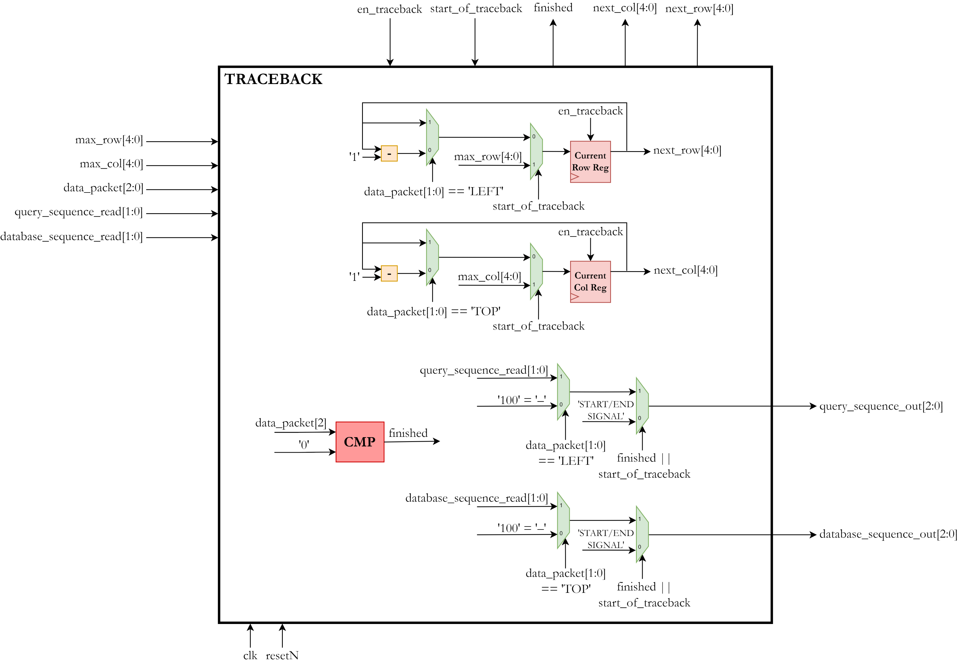
Traceback
32

Slide 48
Next Steps
Finalize full system RTL simulations
Synthesis
Physical design
Tape out (by end of December 2023)
Post-silicon Testing
33

Slide 49

THANK YOU!

